Slide 1






COMPLIANT MANAGEMENT SYSTEM
Team Members: Guide:
Penyamine R Mrs.R.Umamaheshwari
Vasanth M
Manikandan M
TamizhSelvan B
Notes:
1

Slide 2
OUTLINE
Abstract
Problem Statement
Aim & Objectives
Proposed System/Solution
Data Flow Diagram
System Development Approach
Algorithm & Deployment
Conclusion
Future Scope
References
Notes:
These are the list of chapters that we are going to cover in these foundation codes. Those are chapter one what are AI and ML? chapter 2 applied Python programming in AI, and chapter 3 is exploratory data analysis for ML.
2

Slide 3
ABSTRACT:
The project aims to create a web application called "The Issue Tracker" that serves as a reliable complaint management system for improved customer service.
The project aims to enhance customer service by providing a reliable and efficient platform for individuals to report their complaints.
By offering a user-friendly web application, users can easily raise tickets, track the progress of their complaints, and receive timely updates on the resolution process.
The project seeks to promote transparency and accountability in complaint management
Users can register for an account on the web application and log in to access their complaint management features. Users can track the status of their complaint in their personal page on the web application.

Slide 4
PROBLEM STATEMENT:
The people have met problems to complain about corruption in Government Offices and problems with Streetlights, water pipes leakages and road renovation. So people have to visit the admin to complain about these problems .It takes long time and money . There is a need for solution to enhance efficiency and improving customer service.

Slide 5
AIM:
The project aims to create a web application called "The Issue Tracker" that serves as a reliable complaint management system for improved customer service. The main objective is to provide a smart and simple method for individuals to register complaints, track their progress, and resolve them online, eliminating the need for frequent visits to administrative offices
OBJECTIVE:
Develop a responsive HTML-based frontend to facilitate seamless user interaction with the Compliant management system.
Implement Pyhton Flask for robust backend logic, ensuring secure user authentication and Receiving Current Status for Issuers.

Slide 6
PROPOSED SOLUTION:
Develop a Frontend with HTML Pages , CSS and For Backend Python Flask App to provide a access for Issuers about current status of a problem and Good Interface to Admin for Assigning a agent and Upload a current status of a problem .

Slide 7
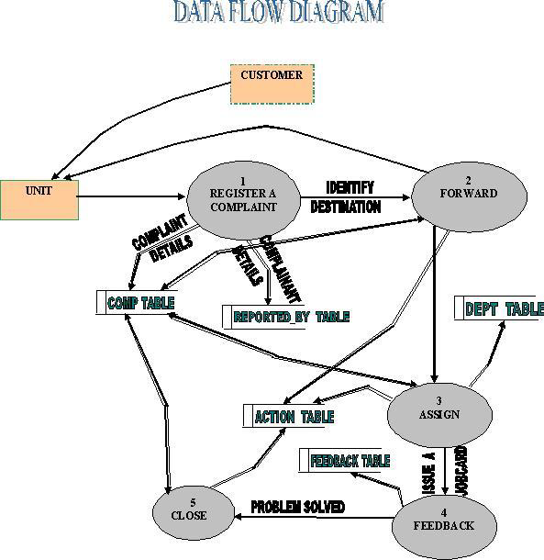

Slide 8
SYSTEM DEPLOYMENT APPROACH:
Technologies Used:
• Programming Languages: HTML, CSS
• Backend Framework : Python Flask
• Database: MySQL
• Deployment: Docker containers with Kubernetes

Slide 9
ALGORITHM & DEPLOYMENT:
Algorithm:
The project described above involves the implementation of various algorithms for different functionalities, but it doesn't specifically refer to a single algorithm by name. Instead, it encompasses a combination of algorithms for tasks such as user authentication, Upload a Problem for Users, Assigning a agent for admin and Upload a current status for Agent.
Deployment:https://aswhttps://github.com/Penyamine/Project/tree/main/Issue_Tracker

Slide 10
CONCLUSION
In conclusion, "The Issue Tracker" project aims to revolutionize complaint management by providing a web application that enables users to register and track their complaints related to streetlights, water pipes leakages, and road renovation.

Slide 11
FUTURE SCOPE
1)Mobile Application:
Developing a mobile application alongside the web application can enhance accessibility and convenience for users. Mobile apps can provide additional features such as push notifications,Direct Conact to admin.
2)Social Media Integration:
Integrating the system with social media platforms can provide an additional channel for users to report complaints and raise awareness about community issues

Slide 12
FUTURE SCOPE
3)Artificial Intelligence and Machine Learning:
Implementing AI and ML algorithms can enhance the system's capabilities. For example, natural language processing can assist in analyzing complaint descriptions and categorizing them accurately.

Slide 13
Thank you!
Notes:
thank you very much for joining this PPT, keep learning.
15

